Slide 1
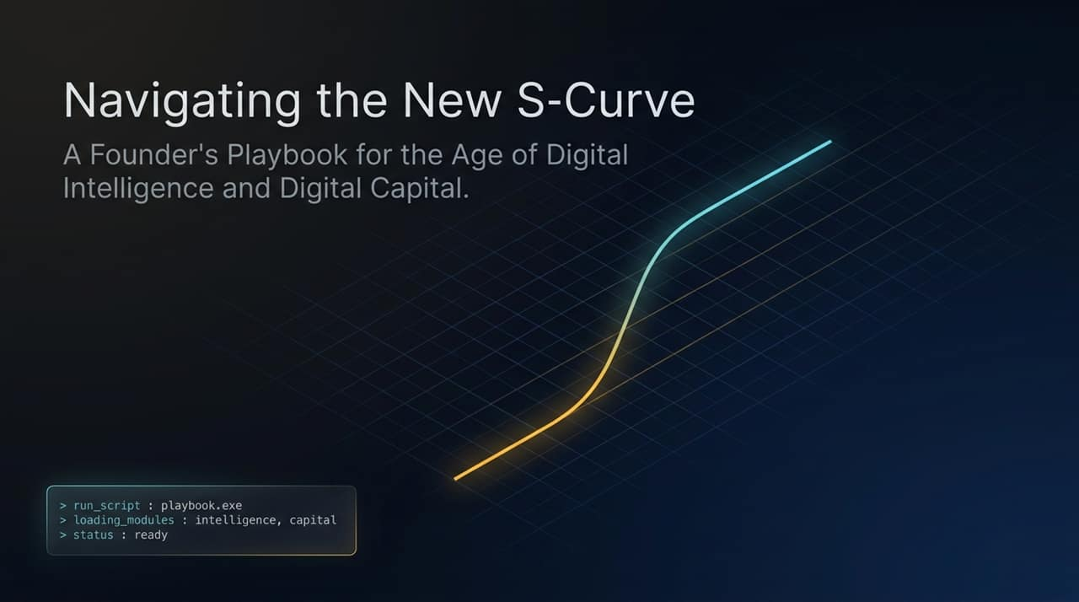
Notes:
Welcome, everyone. Today we are talking about navigating a fundamental paradigm shift: The New S-Curve.
For decades, technology frameworks focused on physical automation or simple software digitization. Today, we stand at the intersection of two powerful forces: Digital Intelligence and Digital Capital.
As you can see on the screen, this playbook isn't about incremental improvements or chasing hype cycles. It’s an execution framework—a guide for founders, builders, and executives on how to operate when cognitive labor becomes essentially infinite and capital strategy requires mathematical precision. Let’s dive in.
https://www.youtube.com/watch?v=CxXgV54KzpQ
https://www.youtube.com/watch?v=1aGpJQ8BMLI

Slide 2
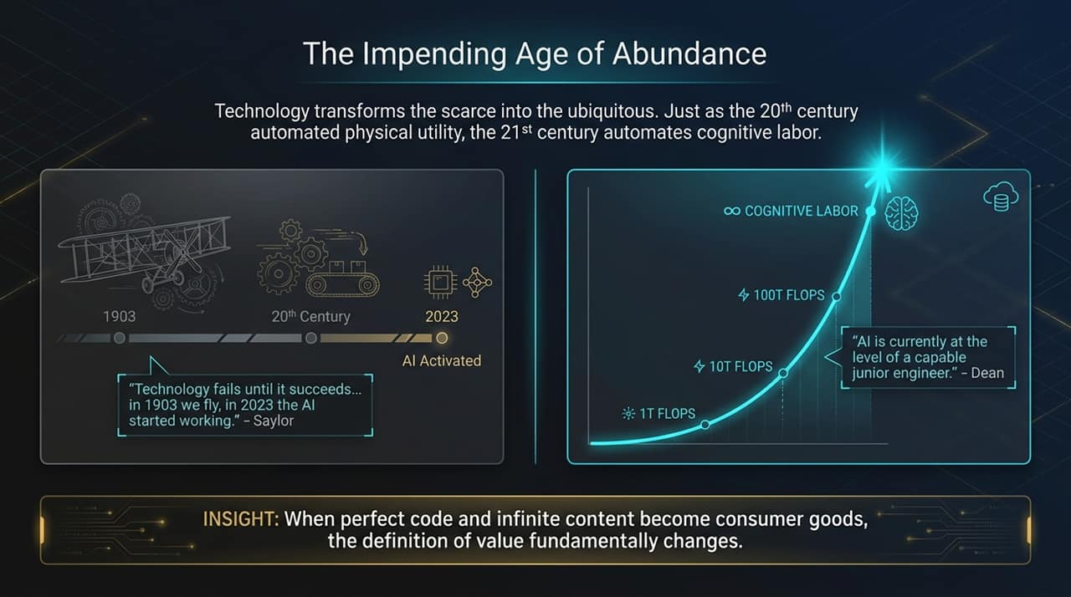
Notes:
To understand where we are going, we have to look at the history of technological shifts. In 1903, humanity mastered mechanical flight; by 2023, AI started truly working. As Michael Saylor noted, technology fails right up until the moment it suddenly succeeds.
Look at the curve: We transitioned from raw compute benchmarks—$1\text{T}$ to $100\text{T}$ FLOPS—into the realm of real cognitive labor. As Jeff Dean famously pointed out, AI has already reached the level of a capable junior engineer.
Here is the core takeaway for every founder in this room: When perfect code, raw software generation, and content creation become baseline commodities, the traditional definition of value collapses. If your entire business model is selling something that AI can synthesize in seconds for near-zero cost, you are on the wrong side of the S-curve.

Slide 3
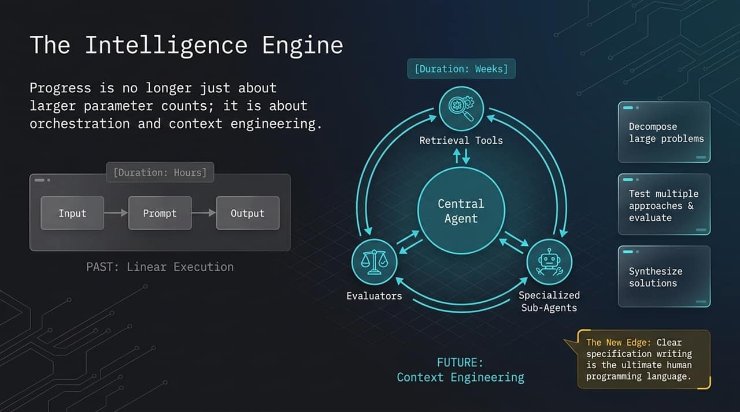
Notes:
So how do we build with modern AI? The era of simple 'prompt engineering'—inputting a quick sentence and getting an output—is fading fast. That was linear execution, measured in hours.
The future belongs to Context Engineering and Agentic Loops. Instead of a human chatting with a model, we deploy a Central Agent backed by specialized sub-agents, retrieval tools, and evaluators. These systems don't just output a single answer; they decompose massive, multi-week problems, test multiple hypotheses, evaluate results, and iterate autonomously.
In this new landscape, the ultimate programming language isn't C++, Python, or Rust—it is flawless specification writing. The competitive edge shifts from who can type code the fastest to who can write clear, unambiguous, hyper-structured context for agentic networks to execute.

Slide 4
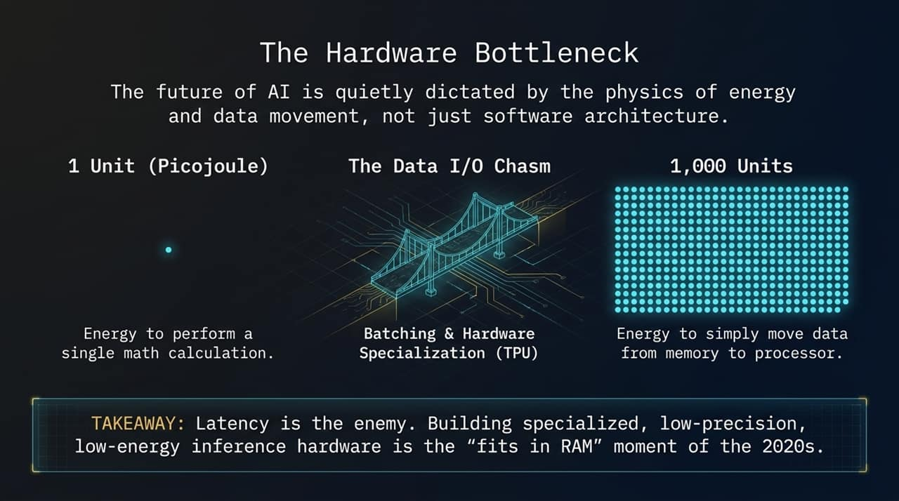
Notes:
While software advances rapidly, it ultimately hits a physical wall: the laws of thermodynamics. The bottleneck of modern AI isn't just parameter counts; it’s energy and data movement physics.
Consider this ratio: It takes roughly 1 unit of energy (a picojoule) to perform a single mathematical computation on a chip. But it takes 1,000 units of energy just to shuffle that data from memory over to the processor! This is the Data I/O Chasm.
Latency and power consumption are the ultimate bottlenecks. This is why hardware acceleration—like specialized TPUs, batching optimization, low-precision arithmetic, and moving compute closer to memory—is critical. Just as fitting data into RAM defined the software revolution of the 1990s, mastering low-energy inference hardware is the defining infrastructure battle of the 2020s.

Slide 5
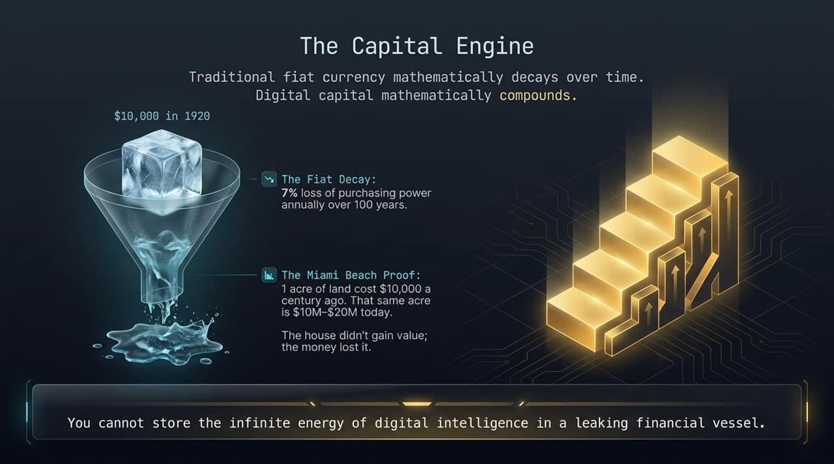
Notes:
Now let's turn to the second pillar of our playbook: Capital. You cannot store the value generated by infinite digital intelligence inside a leaking financial asset.
Look at the Miami Beach example: In 1920, one acre of prime Miami Beach land cost $\$10,000$. Today, that same acre costs $\$10\text{M}$ to $\$20\text{M}$. Did the dirt become 2,000 times more powerful? No. The land remained static—the purchasing power of fiat currency collapsed under a 7% average annual expansion.
Fiat currency inherently decays over time due to supply expansion. Digital capital—specifically scarce, mathematically constrained assets like Bitcoin—compounds value. As a founder or investor, your treasury strategy must account for this: store your enterprise value in hard, non-dilutable assets rather than melting fiat cash reserves.

Slide 6
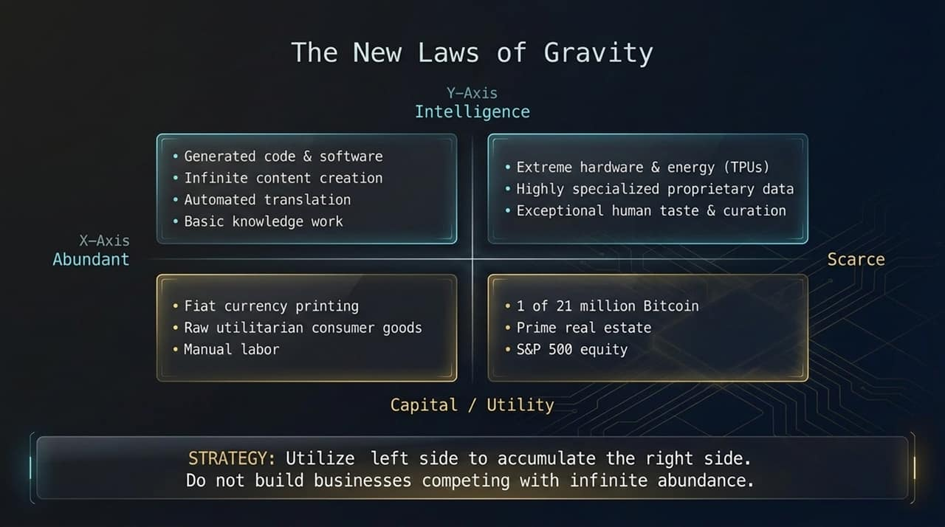
Notes:
This slide represents the core strategic matrix of the entire presentation: The New Laws of Gravity.
On the left, you have items heading toward infinite abundance: basic generated code, automated translation, standard content creation, fiat currency printing, and generic raw labor. If your startup idea sits on the left side of this board, market forces will drive your margins to zero.
On the right, you have irreducible scarcity: specialized hardware/energy (TPUs), proprietary gatekept datasets, exceptional human curation and taste, prime physical real estate, and hard digital assets like Bitcoin.
The Strategy: Use the left side as leverage to capture and accumulate the right side. Use abundant AI and software automation to lower operational costs, generate massive cash flow, and convert that yield into scarce, enduring assets. Never attempt to sell commodity abundance.

Slide 7
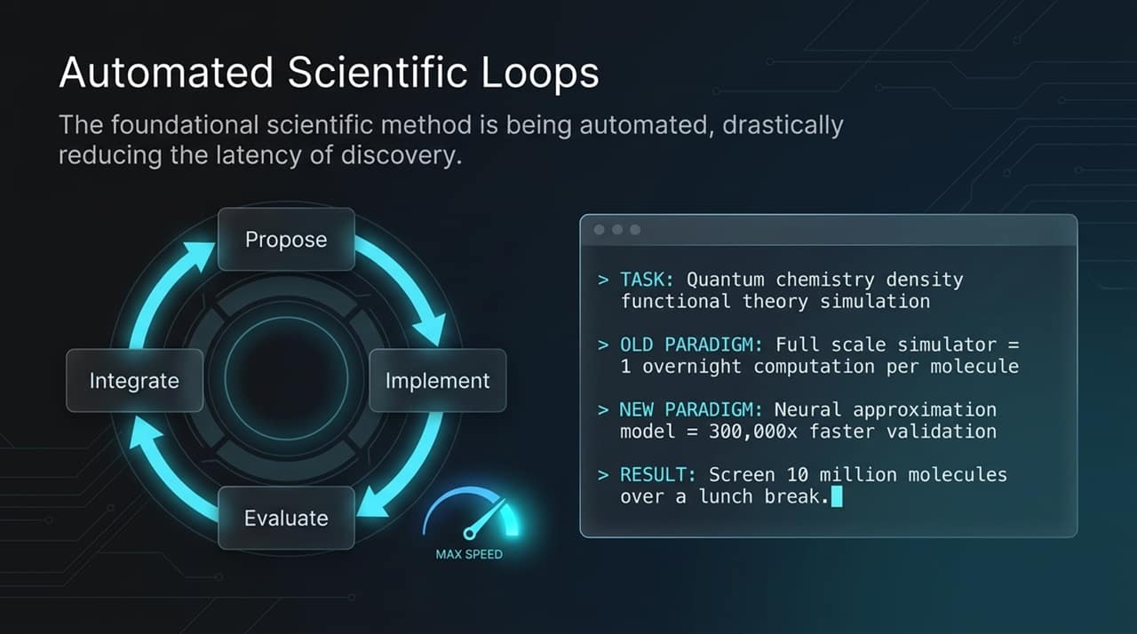
Notes:
Where is AI driving the most exponential leap? In closed-loop scientific discovery.
Traditionally, the scientific method was throttled by human latency. In quantum chemistry or density functional theory, running a full-scale simulator on a single molecule required overnight computations.
Today, neural network approximation models run 300,000 times faster. A team can propose a hypothesis, implement the simulation, evaluate the results, and integrate the learning across 10 million candidate molecules over a single lunch break.
When you compress feedback loops from months to seconds, innovation stops being linear and becomes explosive.

Slide 8
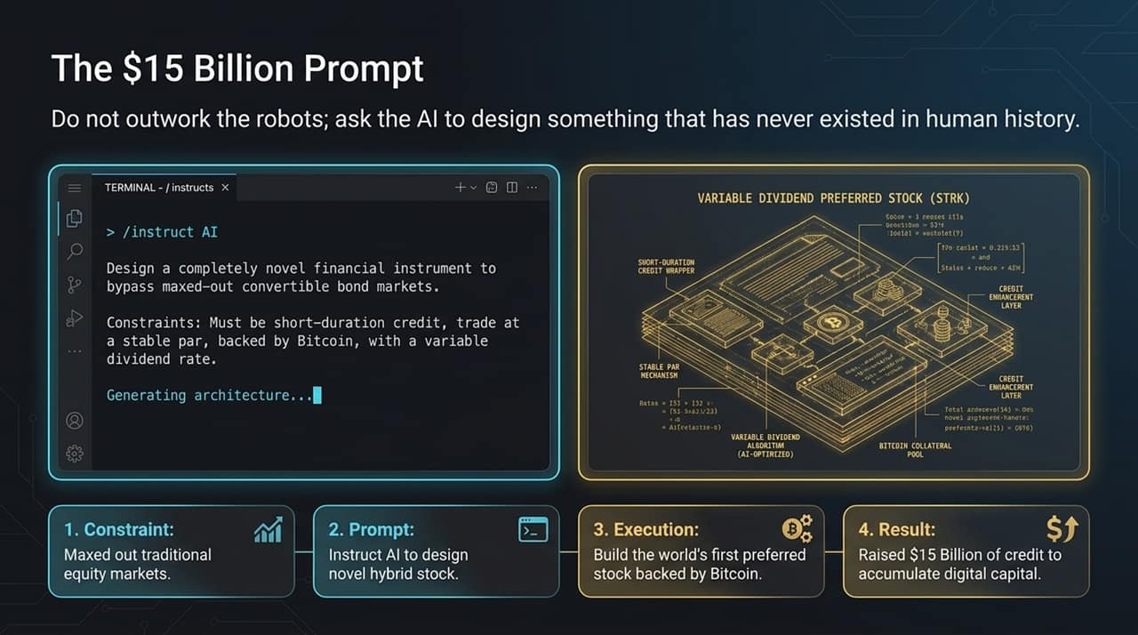
Notes:
Don't just use AI to automate existing tasks—use it to invent structures that have never existed before.
Case in point: Michael Saylor's financial engineering team used high-level constraint reasoning to design a novel financial instrument when traditional convertible bond markets reached capacity.
The prompt specified exact constraints: short-duration credit, stable par value, backed by Bitcoin collateral, with a variable dividend rate. The output was Variable Dividend Preferred Stock (STRK)—a hybrid security structure that raised billions in capital to acquire additional digital assets.
The lesson for founders: Stop trying to outwork the robots at routine execution. Frame the right high-order constraints and let AI architect breakthrough solutions in capital markets, product design, and business models.

Slide 9
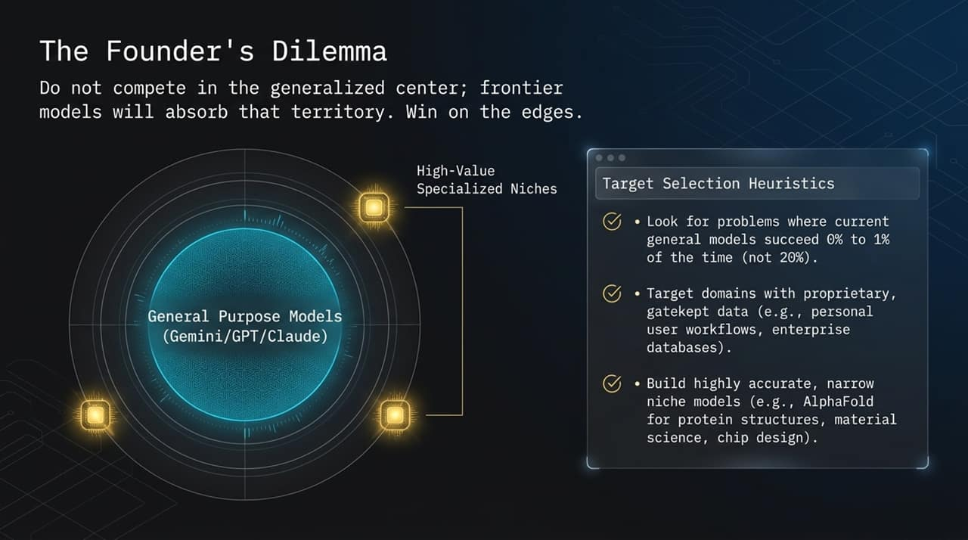
Notes:
If you are building a startup today, you face The Founder's Dilemma.
Do not attempt to compete in the center. General-purpose foundational models like Gemini, GPT-4, and Claude are spending tens of billions on raw intelligence and will continually steamroll mid-tier, generic SaaS wrappers.
How do you win? Win on the edges.
Target 0% Success Problems: Look for highly complex domains where foundational models fail 99% of the time.
Leverage Proprietary Data: Own domain-specific datasets protected behind enterprise firewalls or unique hardware integrations.
Build Hyper-Narrow Precision Models: Think AlphaFold for protein structures, specialized chip design, or niche legal automation. Deep vertical mastery beats broad surface-level capabilities every time.

Slide 10
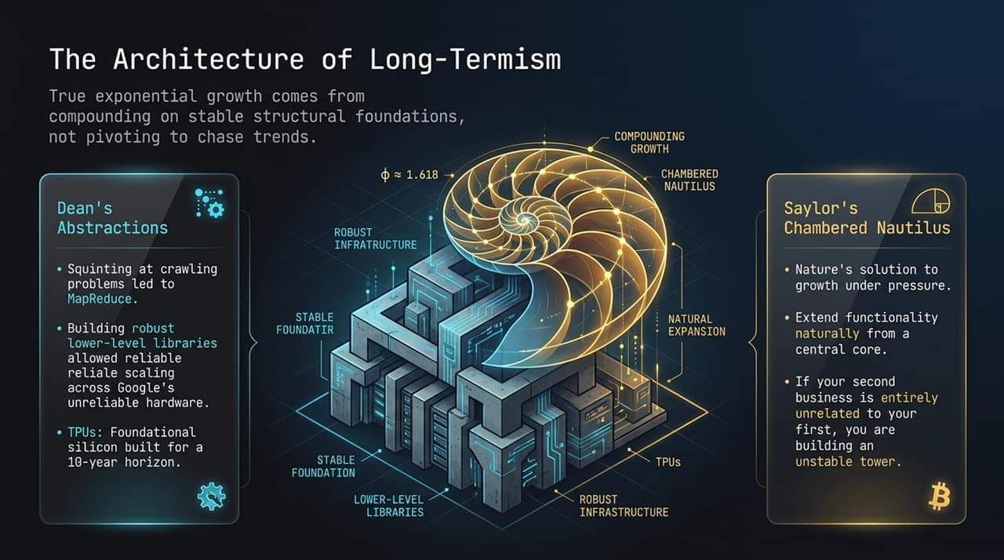
Notes:
Exponential compounding requires structural stability. You cannot build a tall building on a weak foundation, and you cannot build a massive enterprise by constantly pivoting to chase transient viral trends.
We look at two complementary philosophies here:
Jeff Dean's Infrastructure First: Google’s early dominance came from building robust lower-level systems—like MapReduce and custom hardware (TPUs)—that scaled reliably even over unreliable commodity hardware.
Saylor's Chambered Nautilus: In nature, the nautilus expands organically from a strong, central core without destroying its previous chambers.
If your next product initiative or treasury move bears zero relationship to your core foundation, you are accumulating technical and strategic debt. Build low-level abstractions that compound over 10-year horizons.

Slide 11
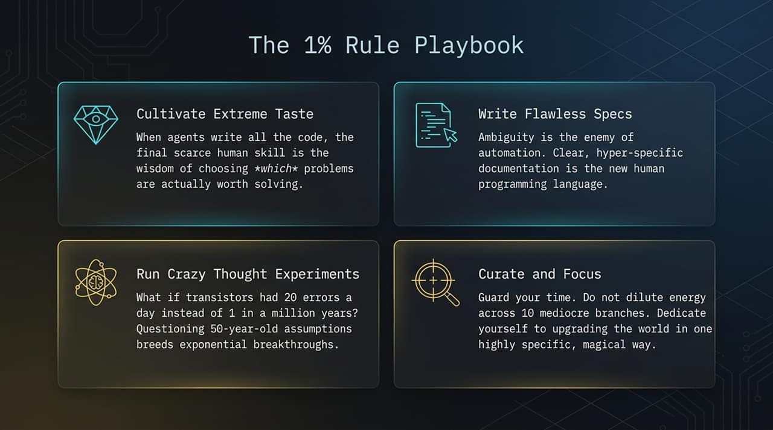
Notes:
To thrive in this environment, founders need to adopt what we call The 1% Rule Playbook:
Cultivate Extreme Taste: When AI agents can produce endless lines of code and content, the ultimate human skill is taste—the judgment to decide what is worth building and what constitutes excellence.
Write Flawless Specs: Ambiguity is the enemy of automated execution. Detailed, clear specifications are your primary leverage.
Run Radical Thought Experiments: Challenge foundational assumptions. Ask questions like: 'What if hardware errors were 100x higher?' or 'What if compute cost zero?' Breakthroughs live at the extremes.
Curate and Focus: Protect your focus fiercely. Do not divide your company's energy across a dozen average ideas; double down on upgrading the world in one specific, transformative way.

Slide 12
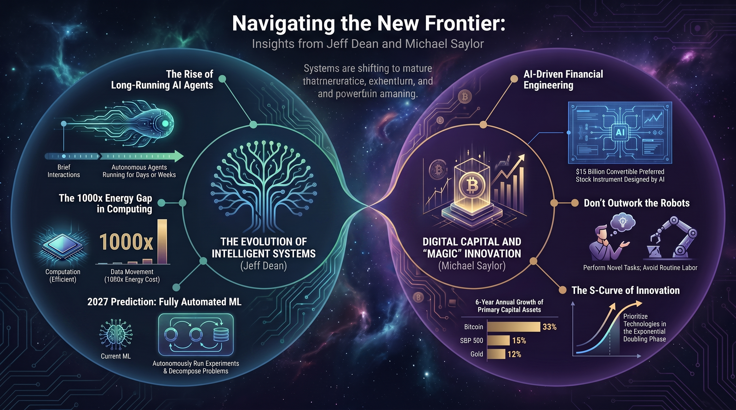
Notes:
To tie everything together, let's look at the grand architecture of the new ecosystem.
On the left, Jeff Dean’s vision of Intelligent Systems: Systems are moving from brief user chats to long-running autonomous agents that run experiments for days or weeks. We are solving the 1000x compute-to-data-movement energy gap and moving toward fully automated machine learning pipelines by 2027.
On the right, Michael Saylor’s vision of Digital Capital: AI allows us to design novel financial instruments—like $\$15\text{B}+$ in structured preferred credit—to accumulate non-devaluing digital assets. Looking at 6-year asset performance, Bitcoin (+33% annualized) has systematically outperformed traditional equity (+15%) and gold (+12%) as a store of digital power.
Final Takeaway: Do not attempt to outwork the robots at routine task execution. Align your company with the exponential doubling phase of the new S-curve, automate your operations using infinite digital intelligence, and anchor your treasury in pristine digital capital.
Thank you, and I am happy to open the floor to Q&A.

